Slide 1
IoT based smart weigh scale and tank monitor
Submitted by: Group 5
Ankitkumar Patel
Gurvinder Singh
Fanse Krutika

Slide 2
Mobile application development

Slide 3
CONTENTS
DESIGNING PLATFORM
HOW IT WORKS
MQTT PROTOCOL
DEMONSTRATION
REFERENCES

Slide 4
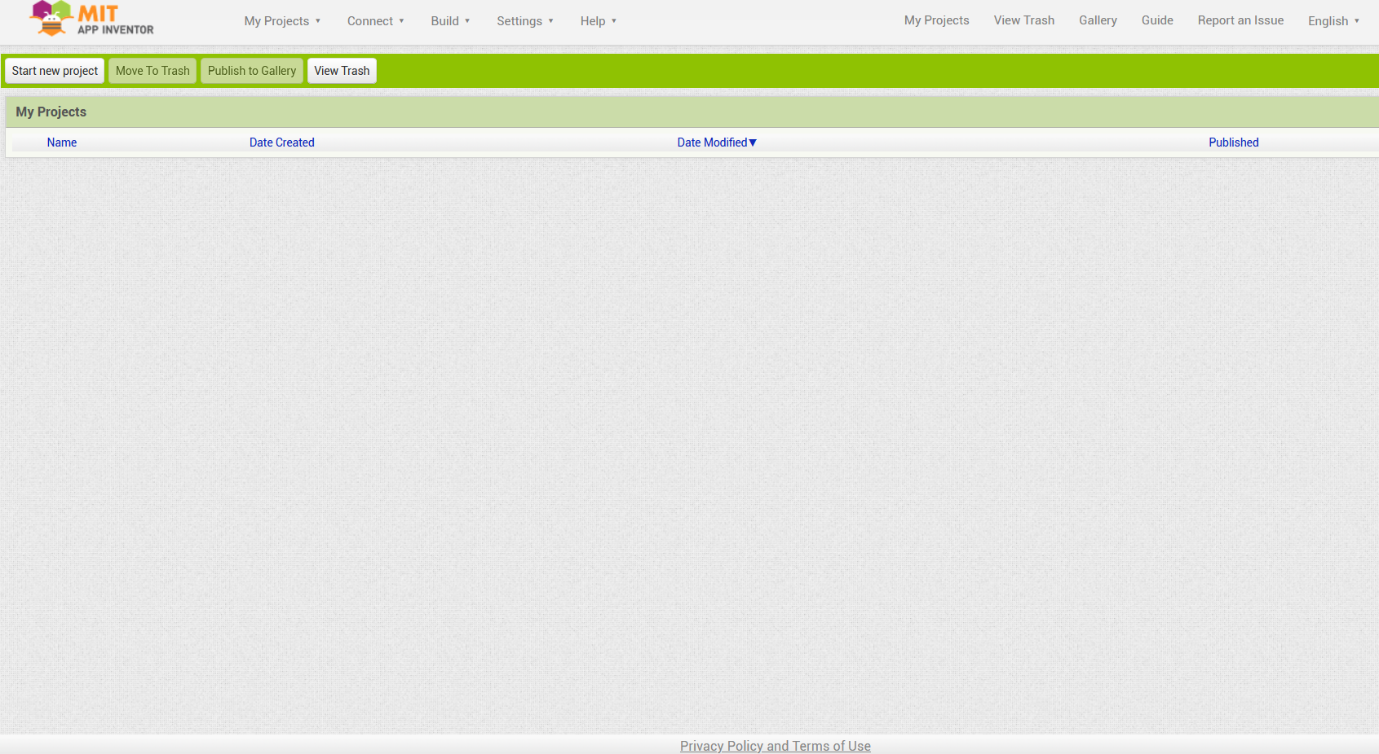
Developing platform (mit App Inventor)
It is an open source platform to develop mobile applications and to teach computational thinking concepts for the applications.
It provides a space to build the mobile applications targeting Android and iOS operating systems.
It is based on the concept of “WHAT YOU SEE IS WHAT YOU GET”.
It offers interfacing in more than 12 languages across the globe.

Slide 5
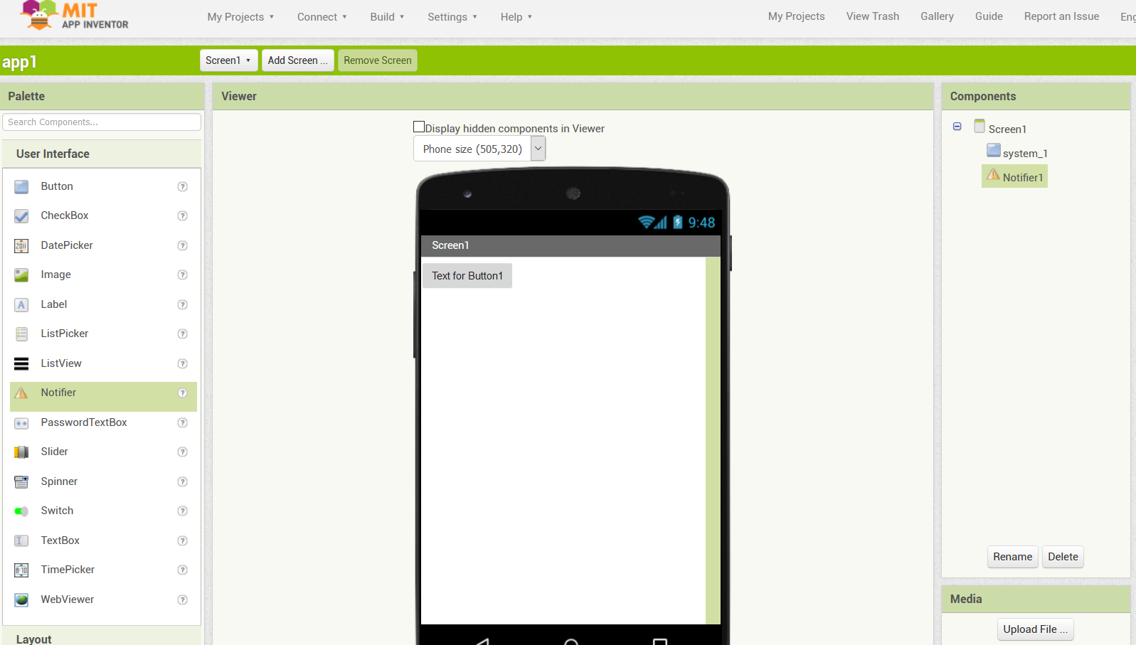
How it works
The user interface of MIT app inventor is composed of two main editors, that are
the design editor (designer)
the block editor.
The designer is a drag and drop interface to disburse the elements of application’s user interface.
In this the user can simply pick element from the palette and place on the main screen to add it to the app.
Inventors can change the properties of the components.
Designer screen

Slide 6
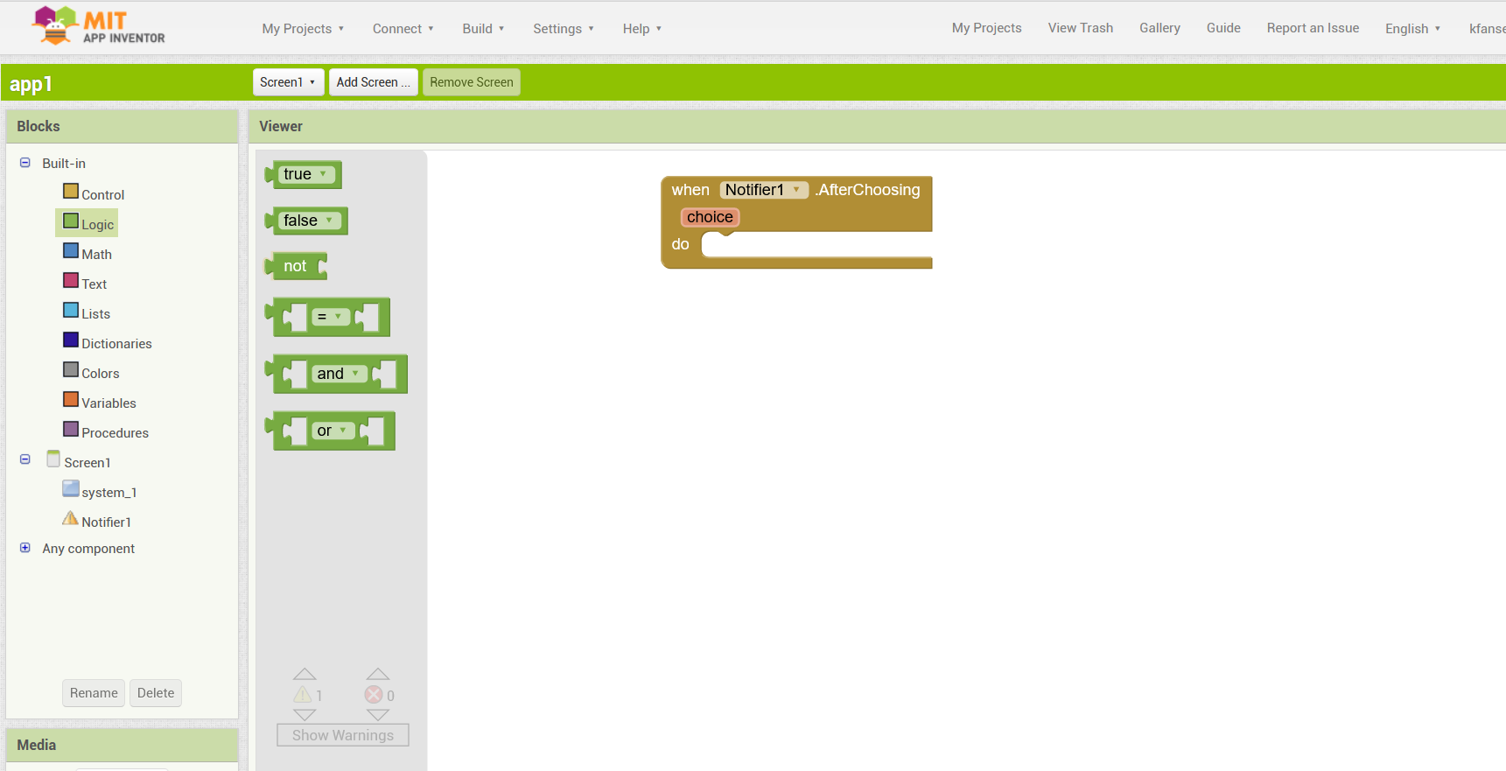
How it works
The block editor is an workspace the enables the designer to visually lay out the logic of the app.
Color coded blocks are used to describe the programming.
For assistance, in development and testing the MIT has also provided mobile application called App Inventor Companion.
Companion can be used for testing and adjusting the designed application
Block editor

Slide 7
MQTT Protocol:- Message Queuing Telemetry Transport.
It was designed by Andy Stanford-Clark (IBM) and Arlen Nipper in 1999 for connecting Oil Pipeline telemetry systems over satellite.
Although it started as a proprietary protocol it was released Royalty free in 2010 and became an OASIS standard in 2014.
MQTT is fast becoming one of the main protocols for IOT (internet of things) deployments.
MQTT basic concepts
Publish/Subscribe
Messages
Topics
Broker

Slide 8
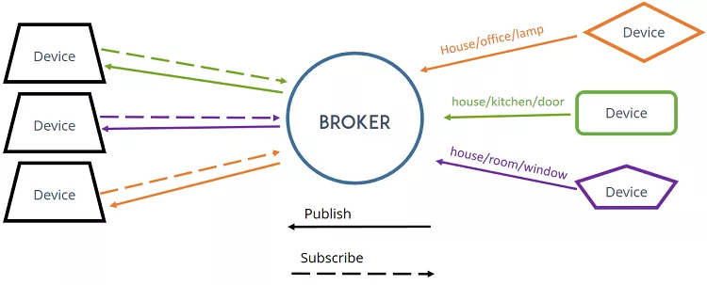
MQTT – Publish/Subscribe
In a publish and subscribe system, a device can publish a message on a topic, or it can be subscribed to a particular topic to receive messages

Slide 9
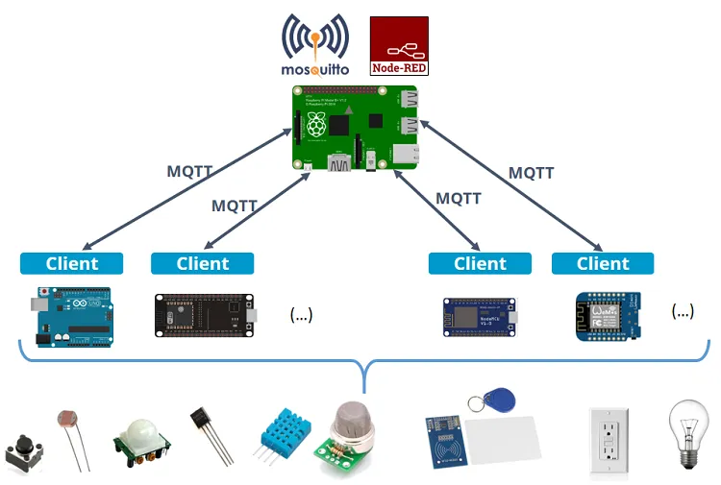
MQTT – Broker
The broker is primarily responsible for receiving all messages, filtering the messages, decide who is interested in them and then publishing the message to all subscribed clients.
Some of the popular Available Brokers:-
Adafruit IO
Mosquitto
Paho MQTT
HiveMQ
Bevywise MQTTBroker
Node-RED

Slide 10
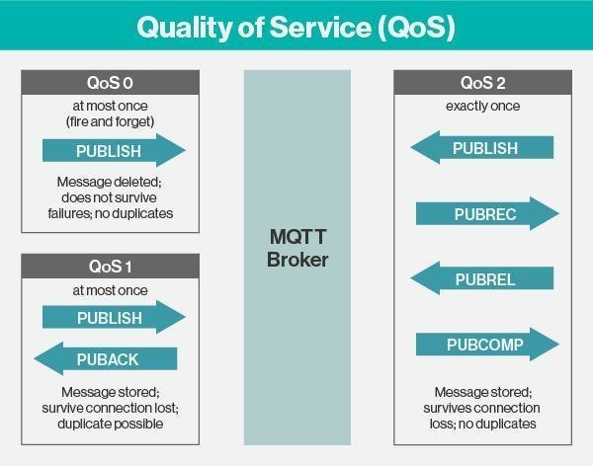
QoS in MQTT
What is Quality of Service?
The Quality of Service (QoS) level is an agreement between the sender of a message and the receiver of a message that defines the guarantee of delivery for a specific message. There are 3 QoS levels in MQTT:
QoS 0:- At most once.
QoS 1:- At least once.
QoS 2:- Exactly once.

Slide 11
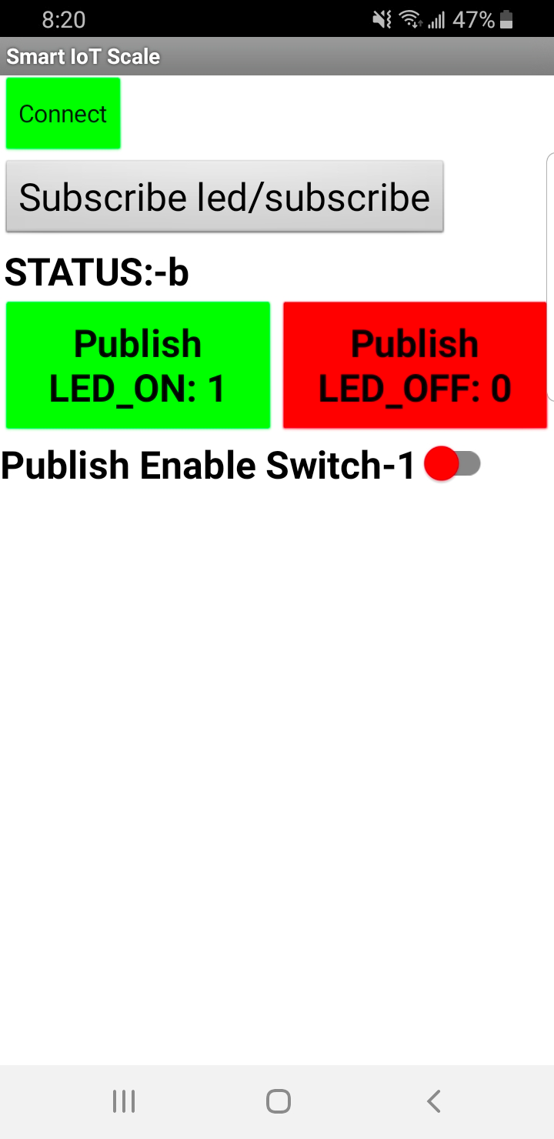
Demonstration
Client:- 1 LTE module + Arduino
Broker:- test.mosquitto.org
Client:- 2 Mobile App
LTE Module + Arduino Board
Broker
(test.mosquitto.org

Slide 12
references
Objectives, Design, and Development, by Patton E.W., Tissenbaum M., Harunani F.
Published on May 3,2019
https://link.springer.com/chapter/10.1007/978-981-13-6528-7_3
What is MQTT and How It Works, by Rui Santos and Sara Santos,
Published on January 15,2017
https://randomnerdtutorials.com/what-is-mqtt-and-how-it-works/
AI2 MQTT Extension: Sensor Readings back and forth, modified on April 24, 2020
https://www.translatetheweb.com/?from=de&to=en&a=https%3A%2F%2Fullisroboterseite.de%2Fandroid-AI2-MQTT-en.html

